Slide 1

Clustering Analysis
DANA 4840 – Group Project
1 August 2024
Notes:
"Hello everyone, welcome to our presentation on Clustering Analysis. This project is part of DANA 4840.

Slide 2




Our team
Maryam Gadimova
Patricia Tating
Roman Shrestha
Aryan Mukherjee
Notes:
First, let me start by introducing our team members: Maryam, Patricia, Roman and me.

Slide 3



Agenda
Breast Cancer Study
Car Model Segmentation
Research Questions
Research Statement
Preliminaries
Pre-clustering Assessment
Clustering Analysis
Cluster Validation
Conclusion and Recommendations
Notes:
Today's presentation will cover the following topics: breast cancer study, car model segmentation and our 2 research questions. Both the studies will have the sections shown on the screen.

Slide 4

Breast Cancer Study
Notes:
We begin with our Breast Cancer Study.

Slide 5

01
Research Statement
Notes:
Let’s move onto the first section: our reaseach statement. The focus of our research is on early and accurate detection of breast cancer, which is critical for effective treatment and patient outcomes.

Slide 6
Research Statement
Breast cancer is a critical health issue, where early and accurate detection is crucial for effective treatment and patient outcomes.
The dataset includes comprehensive measurements of cell nuclei features from breast cancer biopsies, such as radius, texture, perimeter, and area.
K-Means and Partitioning Around Medoids (PAM) clustering methods will be applied to uncover underlying patterns in the data.
The clustering analysis aims to identify potential subtypes and characteristics of breast cancer, providing insights into the disease's heterogeneity.
The study's findings can enhance diagnostic accuracy and support personalized treatment strategies by distinguishing key features between benign and malignant cases.
Notes:
Breast cancer is a critical health issue, and our dataset includes comprehensive measurements of cell nuclei features from breast cancer biopsies, such as radius, texture, perimeter, and area. We applied K-Means and PAM clustering methods to identify potential subtypes and characteristics of breast cancer. The aim is to enhance diagnostic accuracy and support personalized treatment strategies by distinguishing key features between benign and malignant cases.

Slide 7

02
Preliminaries
Notes:
Let's move on to the preliminary EDA of our study.

Slide 8
Breast Cancer Data
Variables | Type | Description
Diagnosis | Categorical | Diagnosis of breast tissues (M = malignant, B = benign)
Radius | Numerical | Radius of the tumor cells
Texture | Numerical | Texture of tumor cells
Perimeter | Numerical | Size of the core tumor
Area | Numerical | Area of the tumor cells
Smoothness | Numerical | Local variation in radius lengths
Compactness | Numerical | perimeter^2 / area - 1.0
Concavity | Numerical | Severity of concave portions of the contour
Concave Points | Numerical | Number of concave portions of the contour
Symmetry | Numerical | Symmetry of the tumor cells
Fractal Dimension | Numerical | “Coastline approximation" of the tumor cells
Data Source:
UCI Machine Learning Repository
Variables:
32 features related to cell nuclei characteristics
Observations:
568 instances of breast cancer biopsies
* The dataset comprises of the mean, standard error and worst values of the above 10 cell nuclei characteristics.
Notes:
"Our data source is the UCI Machine Learning Repository. We analyzed 32 features related to cell nuclei characteristics from 568 instances of breast cancer biopsies. Diagnosis is the only categorical variable and the label.

Slide 9
EDA and Data Pre-processing
Normalization
Features have different scale of measurements.
We standardized the data to ensure each variable contributes equally to the distance calculations, preventing variables with larger scales to have more weight in the clustering results.
Missing Values
No missing values.
Outliers
Several outliers in almost all variables.
The malignant (M) diagnosis consistently shows higher medians and wider ranges across several features.
Data Trends
Given the clinical nature of the data, the outliers have been retained, as they likely represent natural variations rather than measurement errors.
This pattern indicates that M diagnosis forms a distinct cluster characterized by these statistics.
63% of the diagnosis is Benign (B) and 37% is Malignant (M).
Several correlated features.
Notes:
Before diving into the clustering process, we performed some essential preprocessing steps:
We normalized the data to ensure each variable contributed equally to the distance calculations.
There were no missing values.
We retained several outliers, as they likely represent natural variations.
Malignant diagnoses consistently showed higher medians and wider ranges across several features, indicating a distinct cluster. 63% of the diagnoses are Benign, and 37% are Malignant. Several features are correlated.

Slide 10
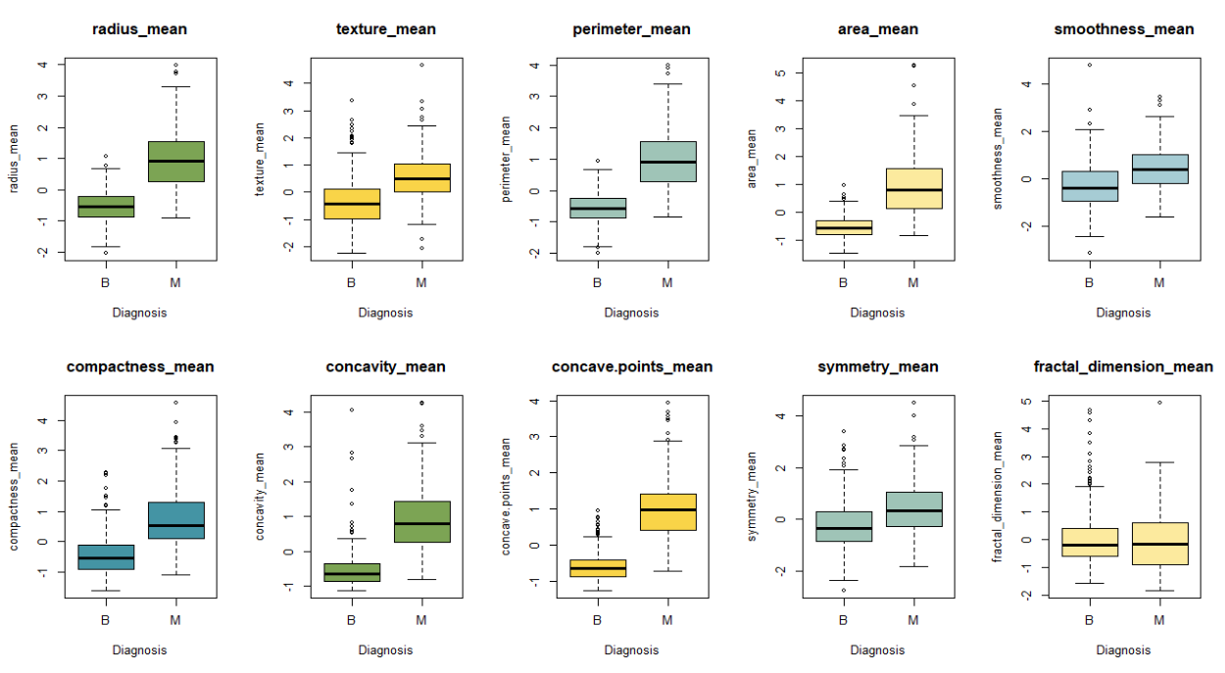
Data Trends
Mean Values
Notes:
We examined boxplots to compare each variable for benign and malignant cancer types. The analysis revealed that malignant cancer generally exhibits higher mean values across almost all variables, with the exception of the fractal dimension.

Slide 11
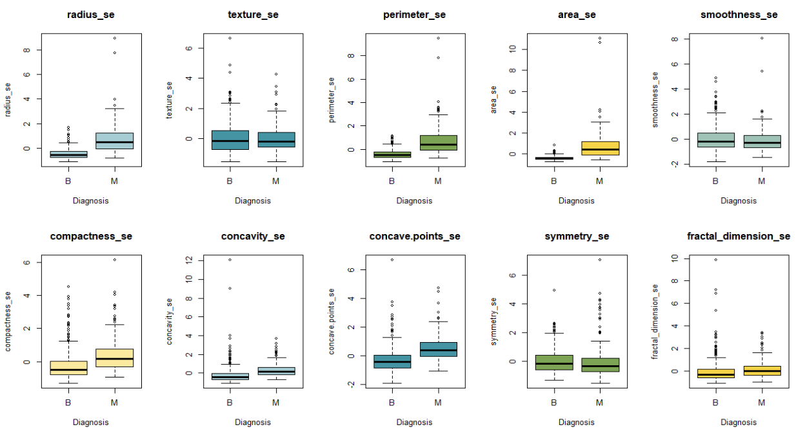
Data Trends
Standard Error
Notes:
Additionally, the standard error for malignant cancer is often greater than or comparable to that of benign cancer.

Slide 12
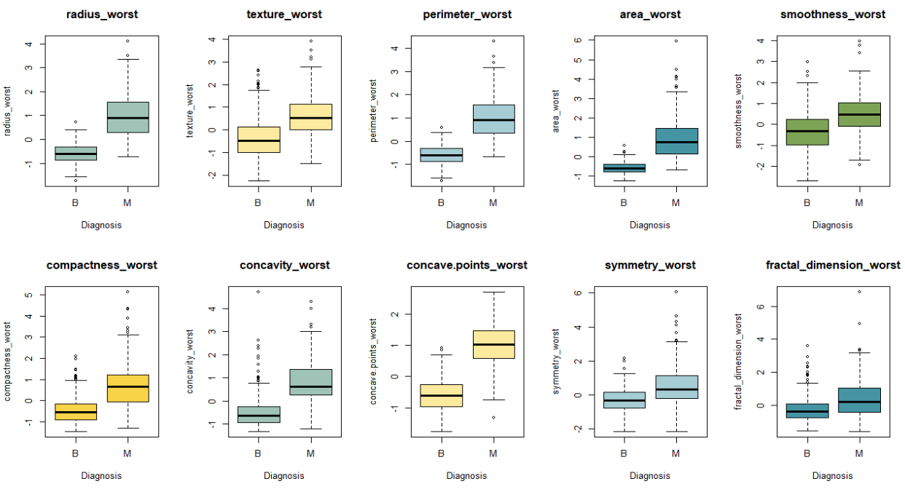
Data Trends
Worst Values
Notes:
Furthermore, the 'worst' values, which refer to the highest observed measurements of each variable, are consistently higher for malignant cancer compared to benign cancer.

Slide 13
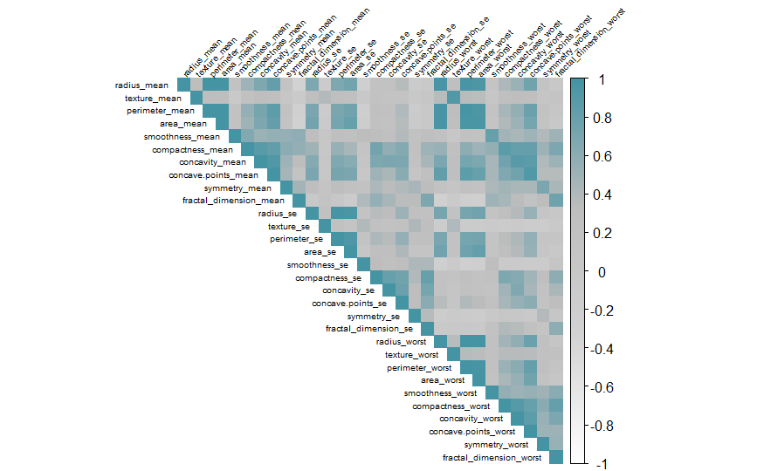
Data Trends
We can clearly see that there exists multicollinearity between features in the dataset.

Slide 14

03
Pre-clustering Assessment
Notes:
Next, we performed a pre-clustering assessment to validate our data clustering.

Slide 15
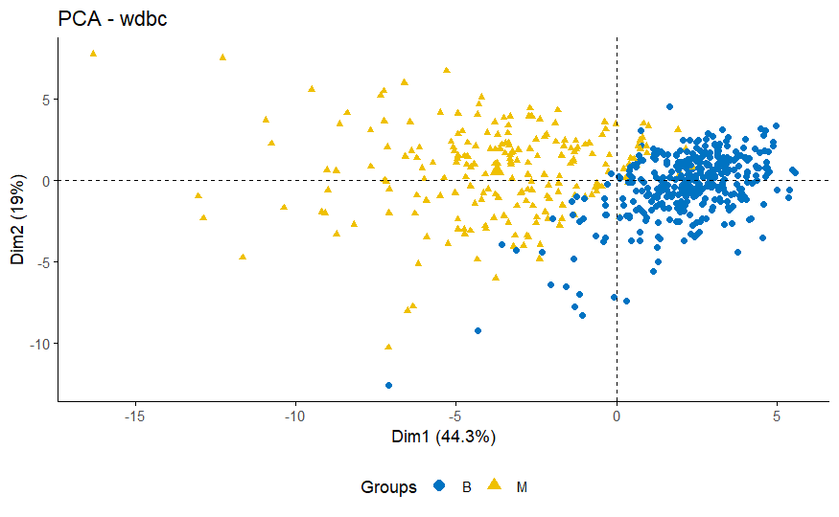
Assessing Clustering Tendency
When visualizing our data, we can clearly see how our Benign and Malignant groups are clustered together. However, we have to validate this clustering.
Notes:
When visualizing our data, we can clearly see the clusters for Benign and Malignant groups. However, we need to validate this clustering.

Slide 16
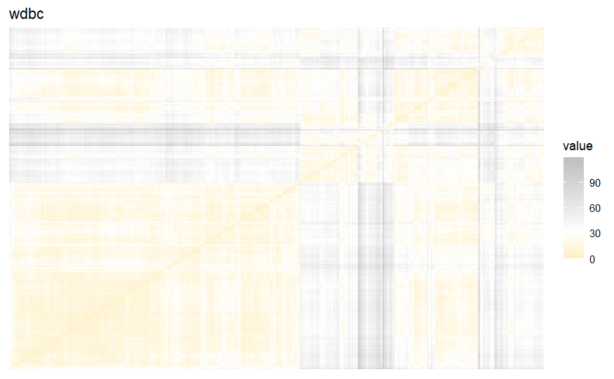
Assessing Clustering Tendency
Hopkins Statistics:
0.9999999
Notes:
Our Hopkins statistic is 0.9999999, indicating a highly clustered data structure.

Slide 17
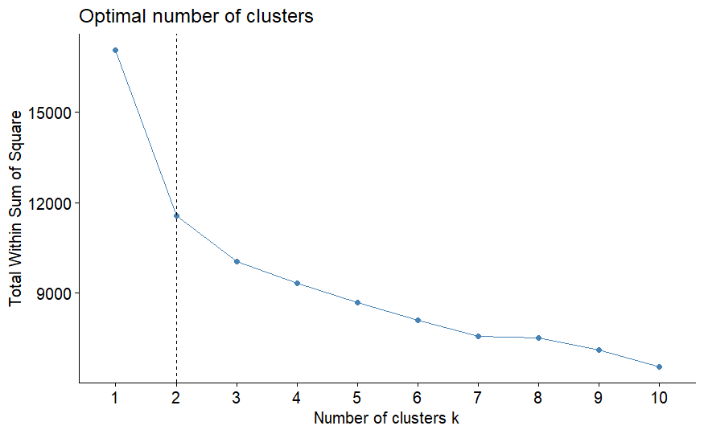
Finding Optimal Number of Clusters
Elbow Method
Optimal number of clusters is k=2, as determined by the elbow method using k-mean clustering.
Notes:
Using the Elbow Method, we determined the optimal number of clusters to be k=2 for K-Means clustering.

Slide 18
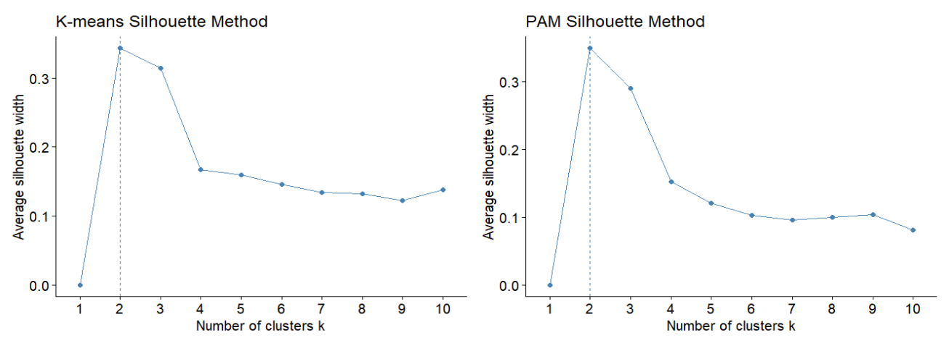
Finding Optimal Number of Clusters
Silhouette Method
Both the K-means and PAM clustering methods indicate that the optimal number of clusters is k=2, as determined by the silhouette method.
Notes:
Both K-Means and PAM clustering methods indicate that the optimal number of clusters is k=2, as shown by the Silhouette Method.

Slide 19
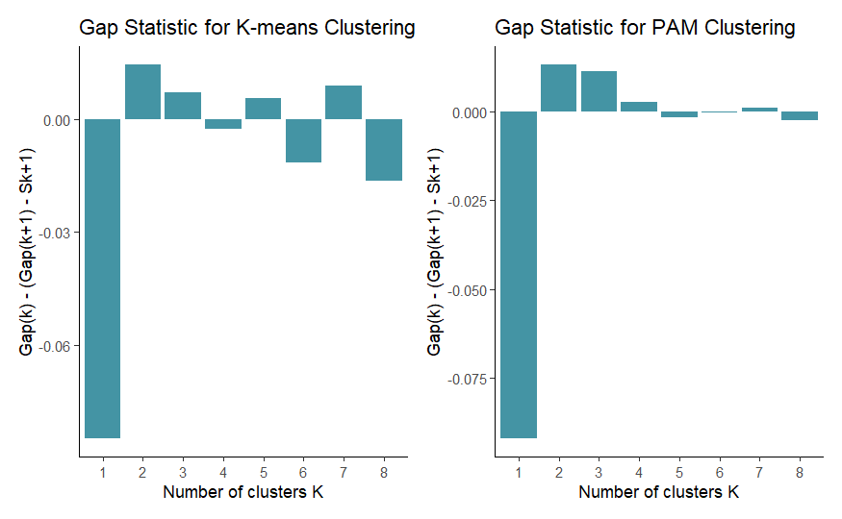
Finding Optimal Number of Clusters
Gap Statistics
Both graphs show gap statistics turning positive in K=2. Overall, the elbow, silhouette, and gap statistics methods all suggest K=2 as the optimal number of clusters.
Notes:
The Gap Statistics method also supports k=2 as the optimal number of clusters

Slide 20

04
Cluster Analysis
Notes:
Moving on to our cluster analysis.

Slide 21
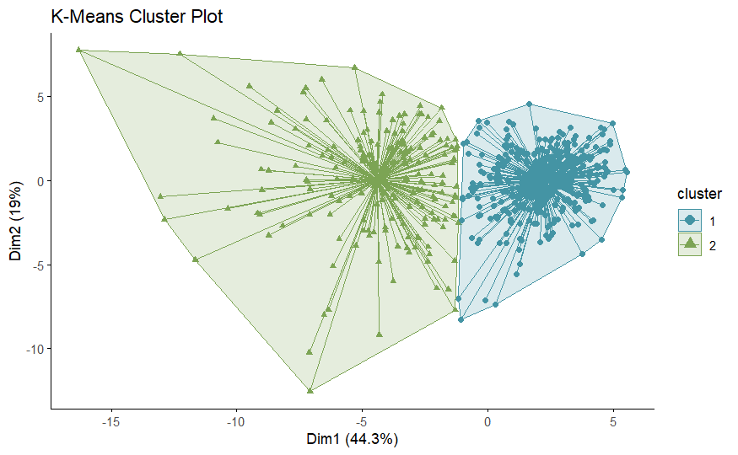
K-Means Clustering
Notes:
Here, you can see the results from K-Means clustering. The clusters are reasonably well-separated with no overlap.

Slide 22
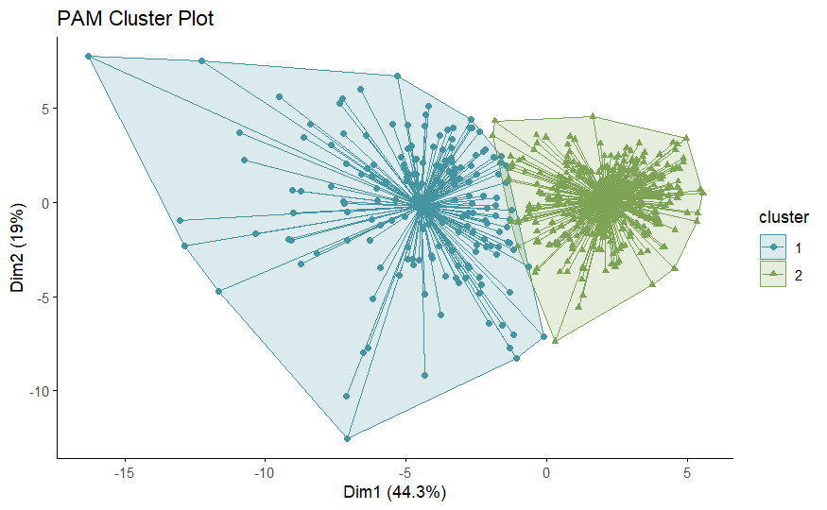
PAM Clustering
Clusters are slightly overlapping
Notes:
In comparison, PAM clustering shows slight overlap between clusters.

Slide 23
We aim for clusters that are compact and well-separated. Upon visual inspection of our plots, we observed that the PAM clusters exhibit slight overlap, indicating that they are not as distinct and well-separated as the clusters formed by K-Means.

Slide 24

05
Cluster Validation
Notes:
Next, we validated our clusters.

Slide 25
External Validation
K-Means Clustering
PAM Clustering
K-Means | Cluster 1 | Cluster 2
Malignant | 175 | 37
Benign | 14 | 343
PAM | Cluster 1 | Cluster 2
Malignant | 167 | 45
Benign | 17 | 340
Rand Index | Adj. Rand Index | E. Index
0.8365 | 0.6707 | 0.5897
Rand Index | Adj. Rand Index | E. Index
0.8055 | 0.6079 | 0.5961
The Rand Index (RI) for K-Means clustering is 0.8365, indicating a strong alignment between the clustering results and the actual diagnosis. For the PAM method, the Rand Index is slightly lower at 0.8055, but still reflects a good agreement with the actual diagnosis, though not as high as with K-Means.
Notes:
We performed external validation by using rand index on both kmeans and PAM.
The Rand Index for K-Means clustering is 0.8365, indicating strong alignment with the actual diagnosis. PAM has a slightly lower Rand Index of 0.8055.

Slide 26
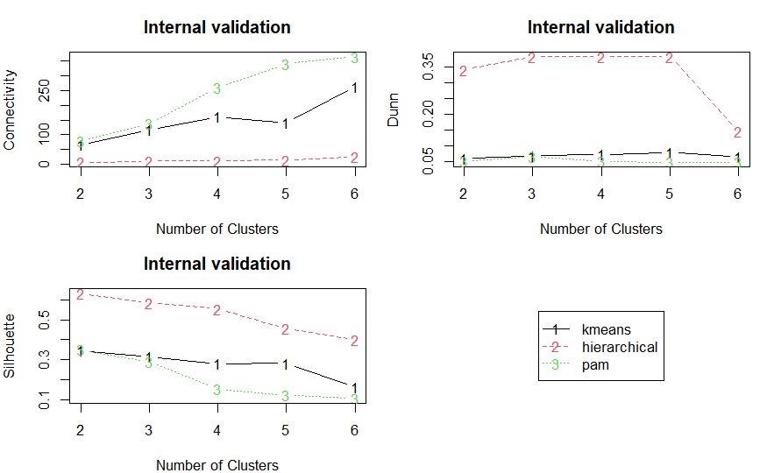
Internal Validation
Optimal Scores:
 | Score | Method | Clusters
Connectivity | 6.7202 | hierarchical | 2
Dunn | 0.3825 | hierarchical | 3
Silhouette | 0.6340 | hierarchical | 2
Notes:
Connectivity: 6.720 for hierarchical clustering with 2 clusters.
Dunn Index: 0.3825 for hierarchical clustering with 3 clusters.
Silhouette Score: 0.6340 for hierarchical clustering with 2 clusters.
The Silhouette Score suggests that the clustering with 2 clusters is well-defined and distinct.
The Connectivity value indicates that the clusters are reasonably well-formed but could potentially be improved.
The Dunn Index for 3 clusters suggests that increasing the number of clusters might not lead to better separation or compactness.
Based on these metrics, it seems that the hierarchical clustering with 2 clusters is performing better overall

Slide 27
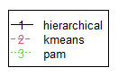
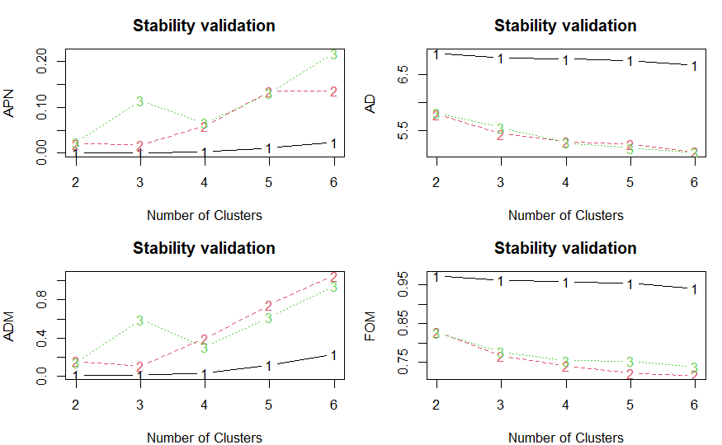
Stability Validation
Optimal Scores:
 | Score | Method | Clusters
APN | 0.0003905487 | hierarchical | 2
AD | 5.1021325696 | pam | 6
ADM | 0.0124118166 | hierarchical | 2
FOM | 0.7159036749 | kmeans | 6
Notes:
For stability validation:APN: 0.000390549 for hierarchical clustering with 2 clusters.
AD: 5.10213257 for PAM clustering with 6 clusters.
ADM: 0.012411817 for hierarchical clustering with 2 clusters.
FOM: 0.715903675 for K-Means clustering with 6 clusters
Based on these metrics, it seems that hierarchical clustering with 2 clusters is performing well in terms of stability and separation.

Slide 28

06
Conclusion and Recommendation

Slide 29
Conclusion
Our results demonstrated that K-Means clustering provided a slightly better alignment with the actual diagnosis labels compared to PAM.
The optimal number of clusters was determined to be two, based on various validation methods such as the Elbow Method, Silhouette Analysis, and Gap Statistics. This result aligns with the ground truth variable or the known diagnosis between benign and malignant tumor.
These findings can contribute to improving diagnostic accuracy and personalized treatment approaches by identifying key features that differentiate between benign and malignant cases, thereby aiding in early detection and targeted therapies.
Notes:
In conclusion, K-Means clustering provided better alignment with actual diagnosis labels compared to PAM. The optimal number of clusters was determined to be two, aligning with the known diagnosis between benign and malignant tumors. These findings can improve diagnostic accuracy and personalized treatment approaches by identifying key features that differentiate between benign and malignant cases

Slide 30
Recommendations
Advanced Clustering Techniques: Explore more advanced clustering techniques such as hierarchical clustering or model-based clustering, which may provide deeper insights into the data structure. We've seen on the internal validation that hierarchical performs better.
Further Feature Analysis: Future research should focus on the significance of individual features and their contributions to the clustering process. This can help in identifying key biomarkers for early detection and treatment planning.
Integration with Clinical Data: Integrating these clustering results with clinical data such as patient history, treatment outcomes, and genetic information could provide a more holistic understanding of breast cancer subtypes and their respective treatment strategies.
Notes:
We recommend exploring advanced clustering techniques such as hierarchical or model-based clustering for deeper insights. Future research should focus on individual features' significance in the clustering process to identify key biomarkers. Integrating clustering results with clinical data could provide a more holistic understanding of breast cancer subtypes and their treatment strategies

Slide 31

Research Question #1
What is the role of dimensionality reduction techniques such as Principal Component Analysis (PCA), t-Distributed Stochastic Neighbor Embedding (t-SNE) or Uniform Manifold Approximation and Projection (UMAP) in enhancing clustering performance?
Notes:
Now I’ll be talking about our Research Question 1, the role of dimensionality reduction techniques like PCA, TSNE and UMAP on enhancing clustering performance.

Slide 32

Challenges in High-Dimensional Data for Clustering
Curse of Dimensionality
Noise and Redundancy
Computational Complexity
Reduced Interpretability
Challenging Visualization
Notes:
Here are some of the challenges we might face when clustering due to high dimension data And these are just a few of em

Slide 33
Benefits of Dimensionality Reduction for Clustering
Improved Cluster Separation
Noise Reduction
Enhanced Interpretability
Reduced Computational Cost
Better Visualization

Slide 34
How Dimensionality Reduction Enhances Clustering
Preprocessing: Applying dimensionality reduction as a preprocessing step helps in removing noise and irrelevant features, leading to more distinct and meaningful clusters.
Visualization and Validation: Techniques like t-SNE and UMAP enable the visualization of high-dimensional data in 2D or 3D, aiding in the validation and interpretation of clustering results.
Feature Selection and Extraction: Techniques like PCA extract the most significant features, which can improve the performance of clustering algorithms by focusing on the most informative aspects of the data.
Distance Measurement: Dimensionality reduction helps in improving the accuracy of distance measurements by removing irrelevant dimensions, making clustering algorithms more effective.

Slide 35
Principal Component Analysis (PCA)
PCA is a linear dimensionality reduction technique that transforms high-dimensional data into a lower-dimensional space while retaining as much variability (information) as possible.
It is widely used for feature extraction, noise reduction, and data visualization.
Notes:
I assume we all know about PCA by now, so I’ll just be touching up on the basic concepts behind it.

Slide 36
Core Concepts of PCA
Variance and Covariance:
Variance measures the spread of data points around the mean.
Covariance measures how much two variables change together. Positive covariance indicates that the variables increase together, while negative covariance indicates that one variable increases as the other decreases.
Principal Components:
Principal components are new variables constructed as linear combinations of the original variables.
They are orthogonal (uncorrelated) to each other and ordered by the amount of variance they capture from the data. The first principal component captures the most variance, the second captures the second most, and so on.
Notes:
I assume we all know about PCA by now, so I’ll just be touching up on the basic concepts behind it.

Slide 37
t-Distributed Stochastic Neighbour Embedding (t-SNE)
t-SNE is a non-linear dimensionality reduction technique developed by Laurens van der Maaten and Geoffrey Hinton.
It is primarily used for the visualization of high-dimensional data in a lower-dimensional space (usually 2D or 3D), while preserving the structure and relationships between data points.
Key Concept: Points that are close in the high-dimensional space should stay close in the low-dimensional space, and points that are far apart should remain far apart.
Notes:
Now I’ll be talking about TNSE, it is a non-linear dimensionality reduction technique, primarily used for the visualization of high-dimensional data in a lower-dimensional space.
The key concept behind it is that points that are close in the high-dimensional space should stay close in the low-dimensional space, and points that are far apart should remain far apart.

Slide 38
Uniform Manifold Approximation and Projection (UMAP)
UMAP is a non-linear dimensionality reduction technique, similar to t-SNE (t-distributed Stochastic Neighbor Embedding), but with several advantages in terms of speed, scalability, and preservation of the global structure of the data.
Developed by Leland McInnes, John Healy, and James Melville, UMAP is grounded in topological and geometric principles.
It optimizes a cost function that preserves both local and global data structure, maintaining the relationships between points in the high-dimensional space when projected to lower dimensions.
Notes:
UMAP is also a non-linear dimensionality reduction technique, similar to TSNE. With advantages in terms of speed, scalability, and preservation of the global structure of the data.

Slide 39
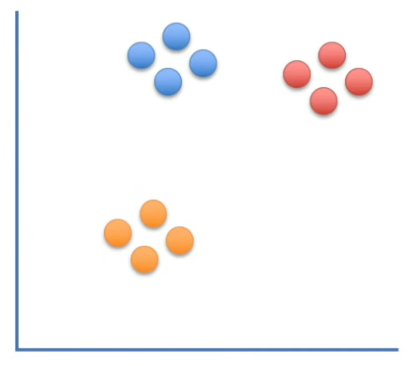
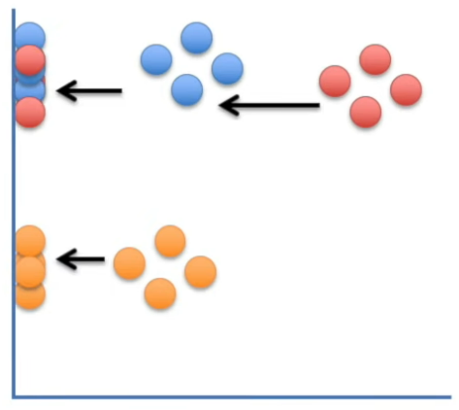
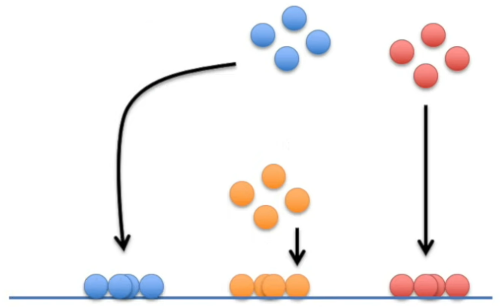
How t-SNE and UMAP work in general?
Let's say we have 2D graph. If we want to reduce this into a flat 1D plot.
If we just project the data on either the x or y axis we would be left with a mess as the original clustering would not be preserved.
So how does t-SNE/UMAP project the data into a low dimensional space such that the high dimensional clustering can be preserved?
Notes:
Lets take a look at how TSNE and UMAP work, in a more general sense.

Slide 40
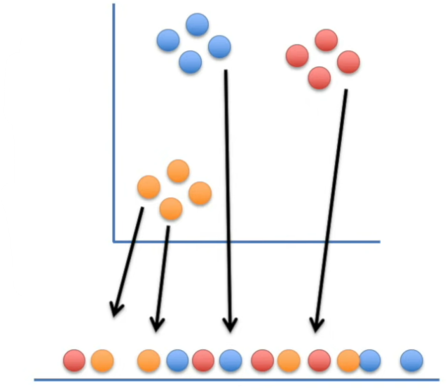
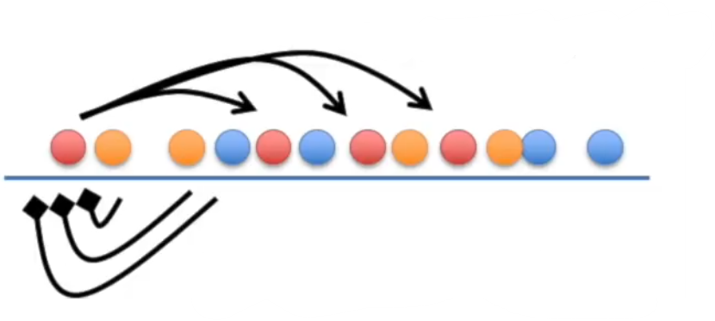
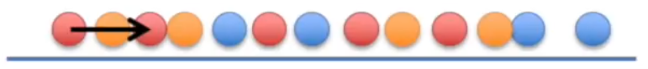
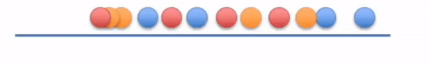
How t-SNE and UMAP work in general?
It will start by projecting the point from the original 2D space on to the 1D space, at random for t-SNE but using something called Spectral Embedding for UMAP.
Let’s see how it moves one of the points - the first red one (R1). R1 wants to move towards the other red points of the same cluster.
But the orange and blue points repel R1. Here, let’s assume the attraction is stronger, so R1 moves a little to the right.
And this will continue until all the points are clustered.

Slide 41
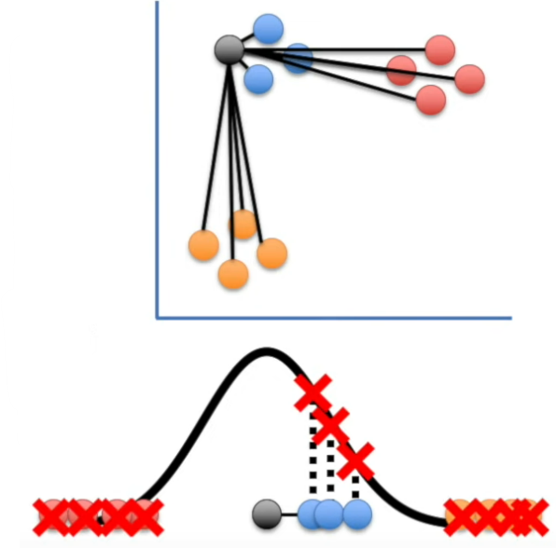
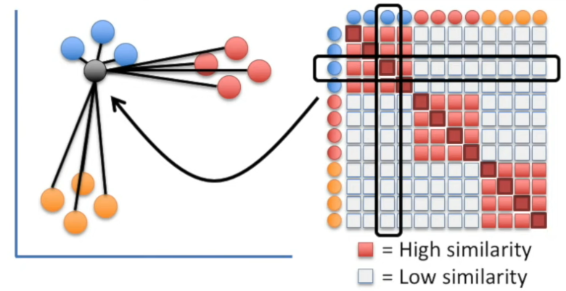
How t-SNE works?
First, the distance between a chosen point and another point is measured, which is then plotted on a Gaussian (normal) curve that is centered on the point chosen.
A line is drawn from the other point to the curve. This process is done for all the points.
After all of which we will end up with a matrix of similarity scores.
Notes:
But what is actually going on?

Slide 42
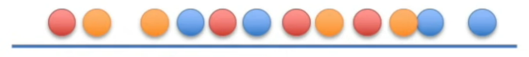
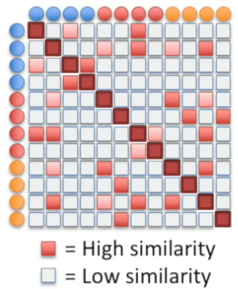
How t-SNE works?
We do the same things as in the previous slide but on the points of the 1D plot.
The distance between a chosen point and another point is measured. This time it is plotted on a t-distribution curve, centered on the point chosen.
As before a line is drawn from the other point to the curve, and the process carried out for all the points.
After all of which we will end up with a matrix of similarity scores.
Notes:
But what is actually going on?

Slide 43
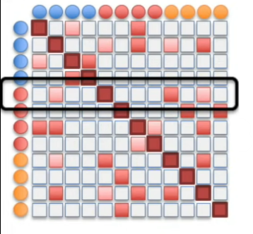
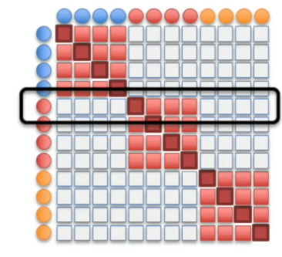
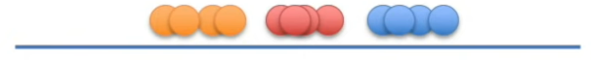
How t-SNE works?
Now the goal is to move the points of the 1D plot so that the similarity matrix of the 1D plot looks like the similarity matrix of the 2D plot.
The t-SNE algorithm moves the points a little at a time, and each step it chooses a direction that makes the matrix on the left look more like the matrix on the right.
Notes:
But what is actually going on?

Slide 44
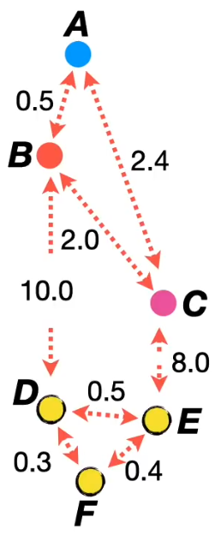
How UMAP works?
Like t-SNE, UMAP calculates the distances between each pair of points in the 2D plot, but the way to calculate the similarity scores vary.
The distances are not plotted on a normal curve and instead on a curve shaped depending on the most important parameter of UMAP, something called the number of neighbors.
Smaller value of number of neighbors is like seeing the details but not the bigger picture but larger value give a bigger picture but less detail.
UMAP uses the value from the formula: log₂(num.neighbours), to define the shape of the curve.
Notes:
But what is actually going on?

Slide 45
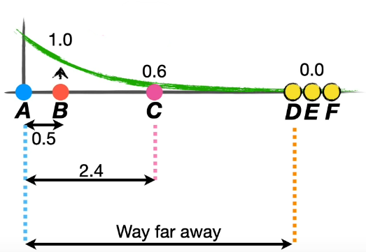
How UMAP works?
So, if we take A as the chosen point and plot the other points according to their distances from A like in t-SNE. And we choose the number of neighbors to be 3, log₂(3) = 1.6.
We get a plot as seen on the right.
Here, UMAP scales the curve such that the sum of the high dimension similarity scores will be 1.6.
We do this and calculate the similarity scores for all the of the points.
Notes:
But what is actually going on?

Slide 46
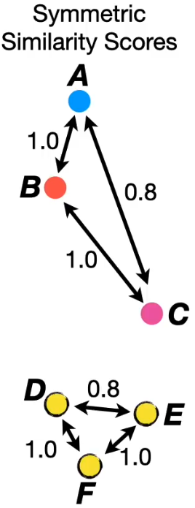
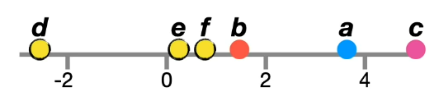
How UMAP works?
UMAP then initializes a low dimensional graph using Spectral Embedding. This make it so that every time UMAP is used on the same dataset, the same low dimensional graph is initialized.
UMAP now pick two points on random based on their high dimension similarity scores (higher similarity scores more likely to be selected first).
If UMPA selects points a and b to move closer together. It then also randomly selects a point (which are not in a or b’s high dimensional cluster) to move farther away from.
Notes:
But what is actually going on?

Slide 47
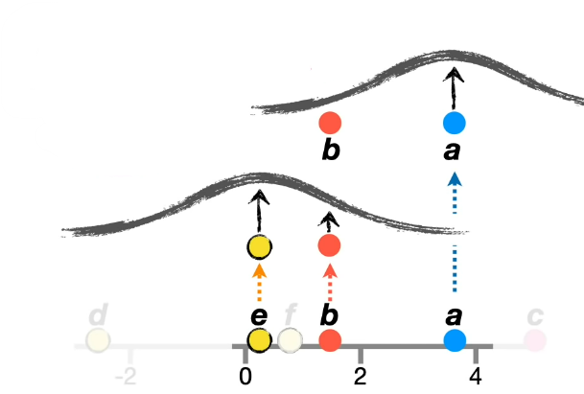
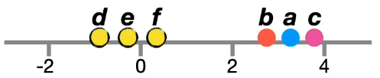
How UMAP works?
Now to actually move the point b closer to a but farther from for example point e, UMAP needs to calculate the low dimension similarity scores for both b-a and b-e.
But this time a t-distribution curve is used to calculate the low dimension similarity scores.
Here, UMAP moves the point b such that that low dimension score to a is maximized and score from e is minimized.
This process is done for all the points until the clusters are far from each other like in the 2D plot.
Notes:
But what is actually going on?

Slide 48
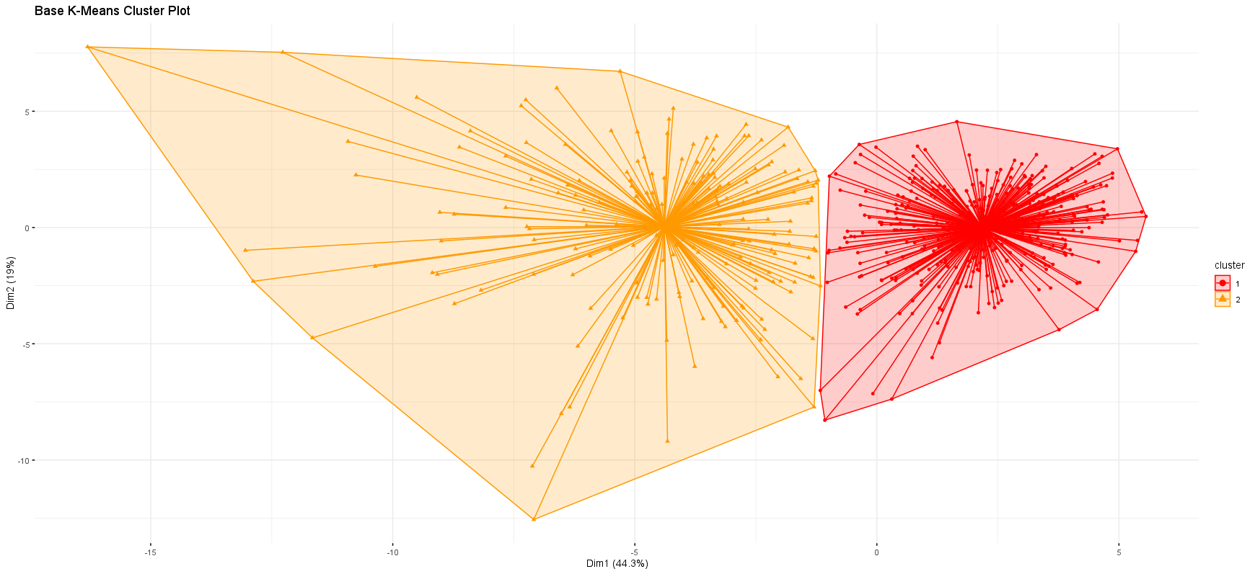
Practical results on our Breast Cancer Dataset
Base
The clusters are reasonably well-separated with no overlap, and with an Adjusted Rand Index of 0.6707 indicates a good level of agreement with the actual results.

Slide 49
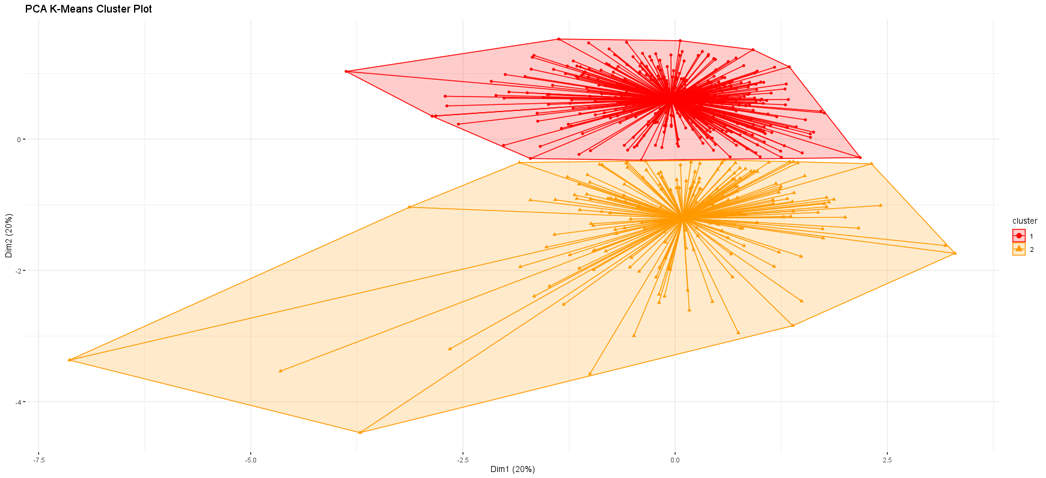
Practical results on our Breast Cancer Dataset
PCA
Visually PCA provides clusters that are not very well-separated and seem to have slight overlap. Even when the number of dimensions are dropped from 30 down to 5, looking at the Adjusted Rand Index of 0.6707 it shows good level of agreement with the actual results.
Notes:
We are reducing the dimensionality (and complexity) while maintaining the same results.

Slide 50
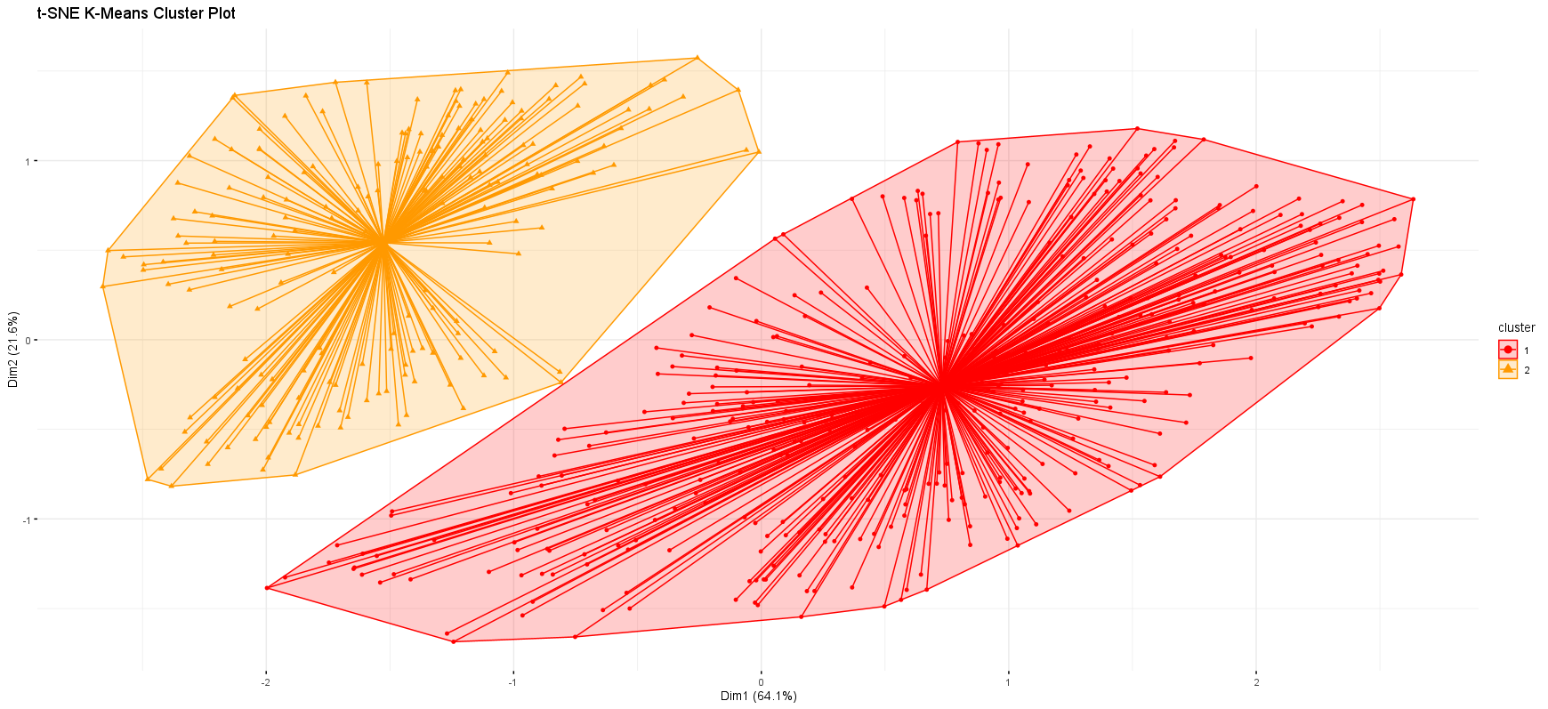
Practical results on our Breast Cancer Dataset
t-SNE
Visually t-SNE provides clusters that are well-separated with no overlap. With an Adjusted Rand Index of 0.7731, it shows a drastic improvement in the performance of the clustering method from the base.
Notes:
This is even with only 3 dimensions.

Slide 51
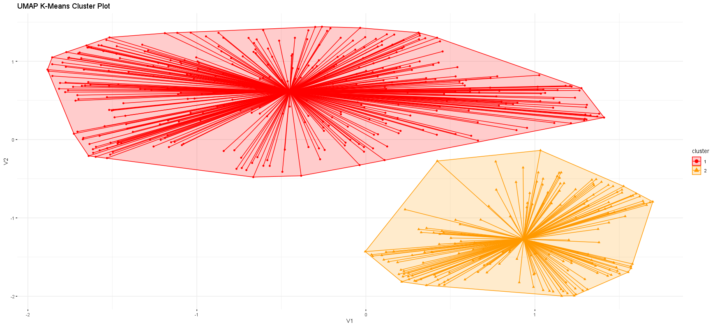
Practical results on our Breast Cancer Dataset
UMAP
Visually UMAP provides clusters that are very well-separated with no overlap. With an Adjusted Rand Index of 0.7794, it shows the highest improvement in the performance of the clustering method.
Notes:
This is with dimension reduction to only 2.
Looking at all of these results we can confidently say that dimensionality reduction techniques can significantly enhance the clustering performance.

Slide 52
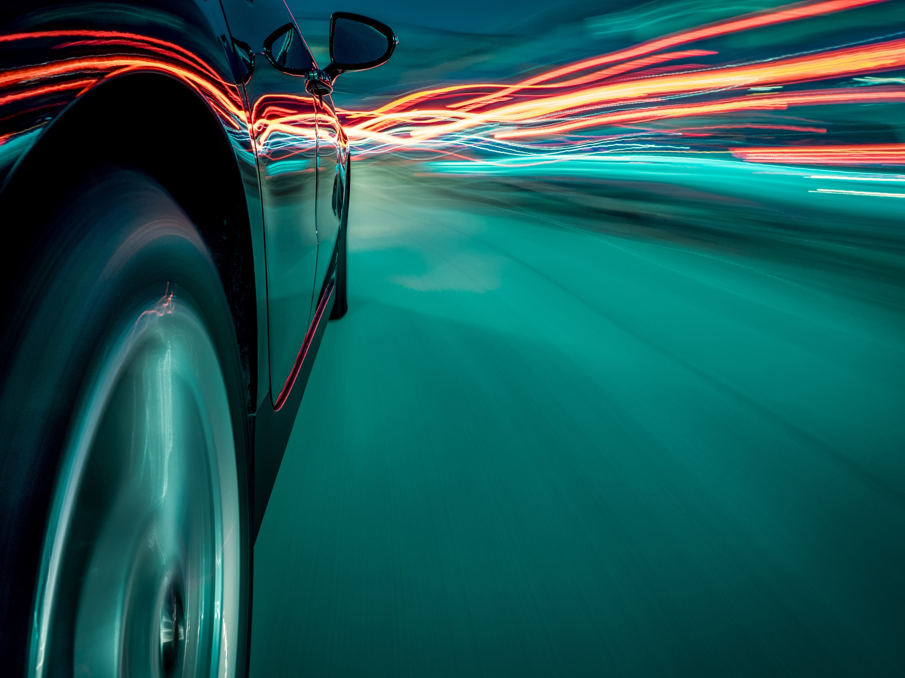
Car Model Segmentation

Slide 53
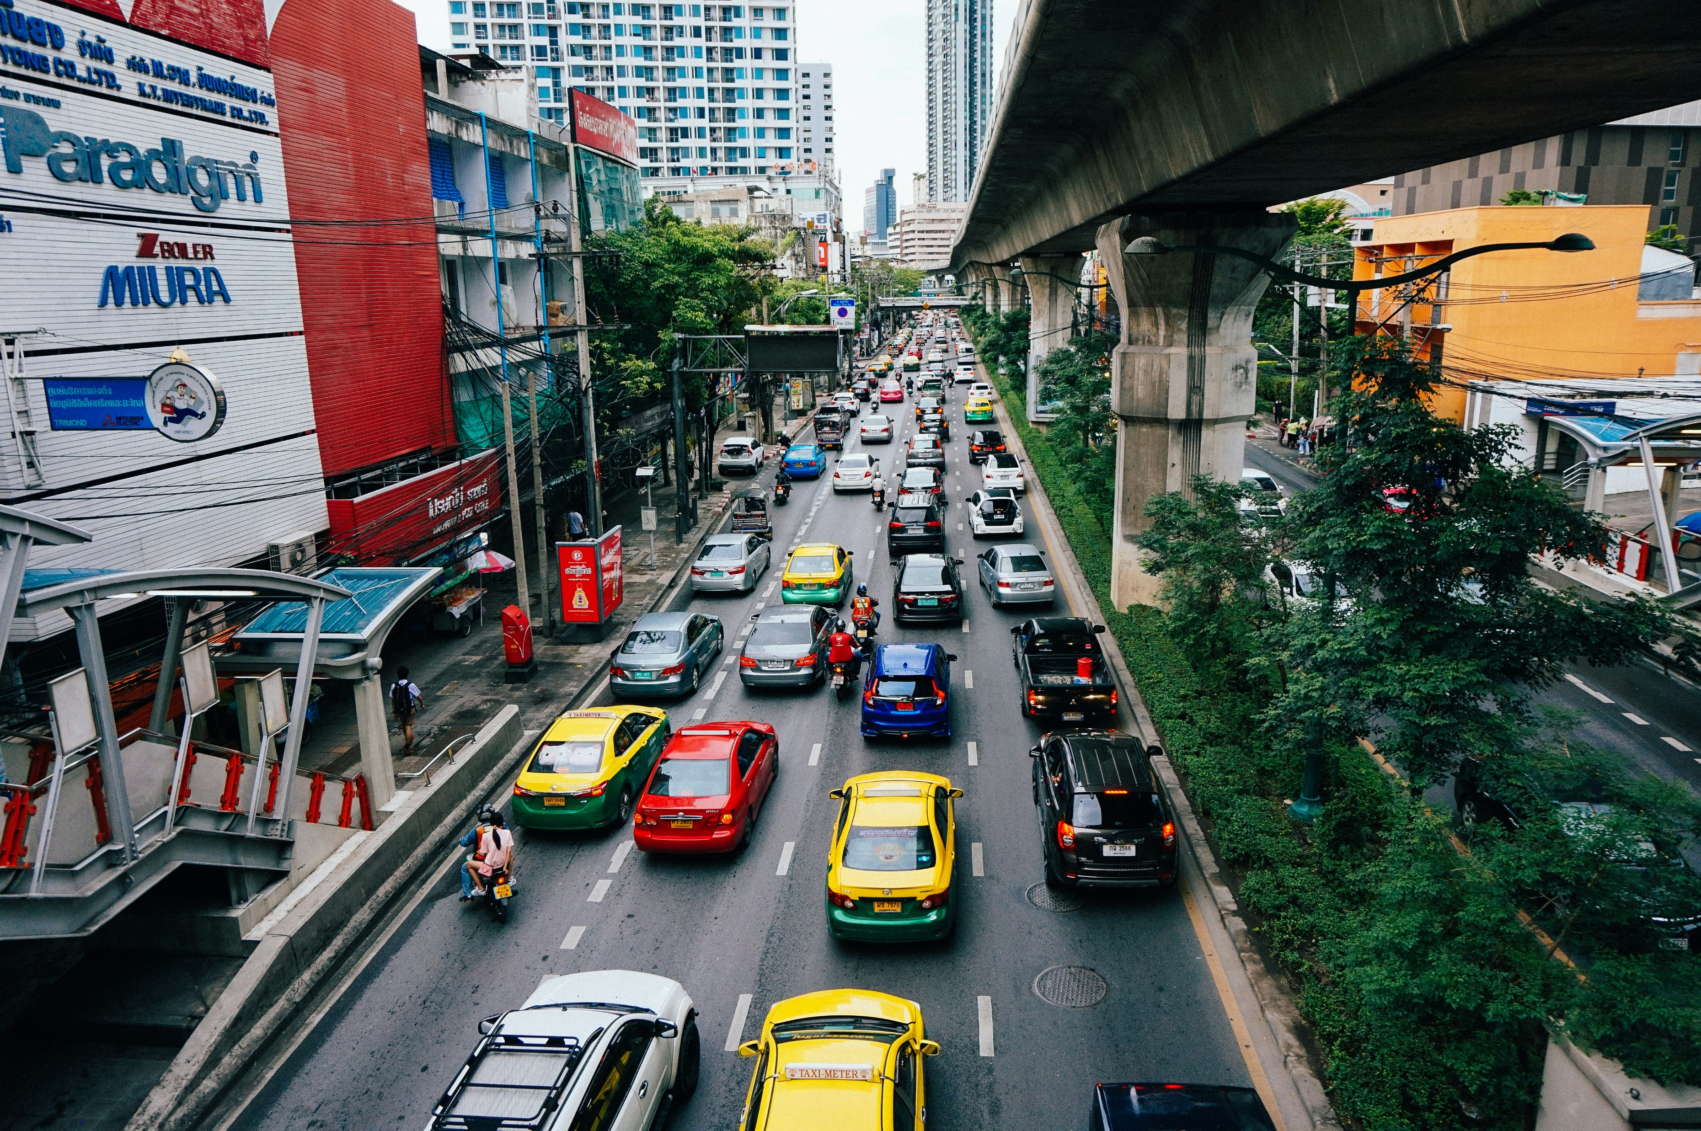
01
Research Statement

Slide 54
Research Statement
The automobile industry aims to understand various car model characteristics and performance to cater to diverse customer needs.
The dataset includes attributes like weight (wt), horsepower (hp), engine displacement (disp), and miles per gallon (mpg), useful for categorizing cars.
The analysis aims to segment car models into clusters, representing different vehicle types such as high-performance sports cars, fuel-efficient vehicles, or family-oriented models.
Clustering helps reveal underlying data patterns, enabling marketers and producers to more effectively target specific customer segments.

Slide 55
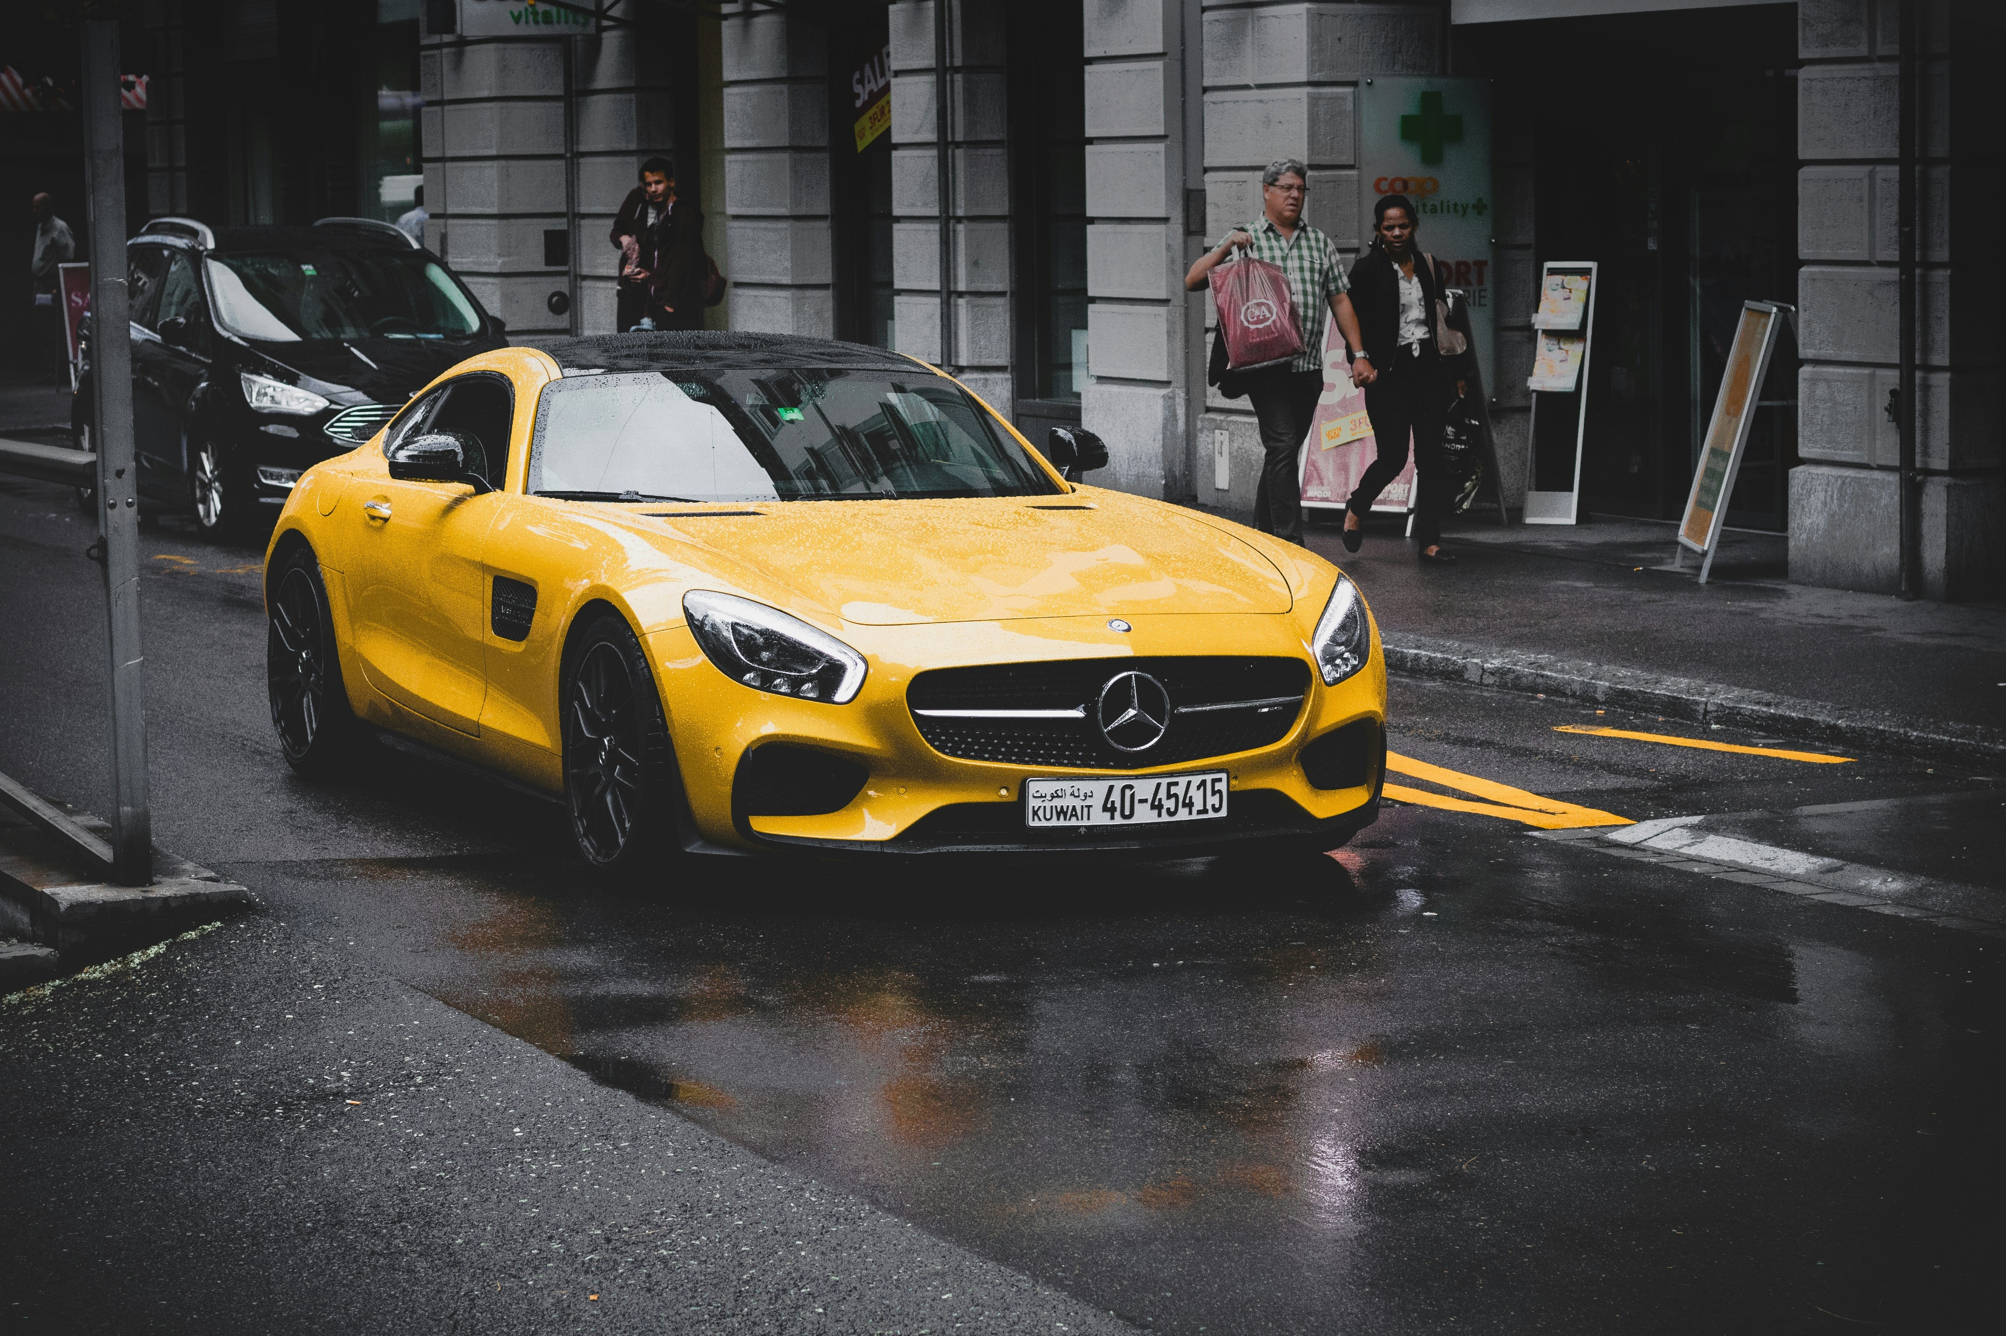
02
Preliminaries

Slide 56
MT Cars Data
Data Source:
Kaggle
Variables:
12 automobile features
Observations:
32 observations of different car models
Variables | Type | Description
model | Categorical | Model of vehicle
mpg | Numerical | Miles/(US) gallon
cyl | Categorical - Ordinal | Number of cylinders
disp | Numerical | Displacement in cubic inches
hp | Numerical | Gross horsepower
drat | Numerical | Rear axle ratio
wt | Numerical | Weight (1000 lbs)
qsec | Numerical | 1/4 mile time, a measure of acceleration
vs | Binary | Engine (0 = V-shaped, 1 = straight)
am | Binary | Transmission (0 = automatic, 1 = manual)
gear | Categorical - Ordinal | Number of forward gears
carb | Categorical - Ordinal | Number of carburetor

Slide 57
EDA and Data Pre-processing
Normalization
Missing Values
No missing values.
Outliers
One outlier in ‘qsec’, one outlier in ‘hp’ and two outliers in ‘wt’.
Variables 'qsec', 'hp', and 'disp' have lower medians and narrower ranges than 'wt', 'drat', and 'mpg'.
Data Trends
Features have different scale of measurements.
We standardized the data to ensure each variable contributes equally to the distance calculations, preventing variables with larger scales to have more weight in the clustering results.
Given the small size of the dataset, the decision was made to retain the outliers.
Distribution of most of the numeric data are skewed either to the right or left.

Slide 58
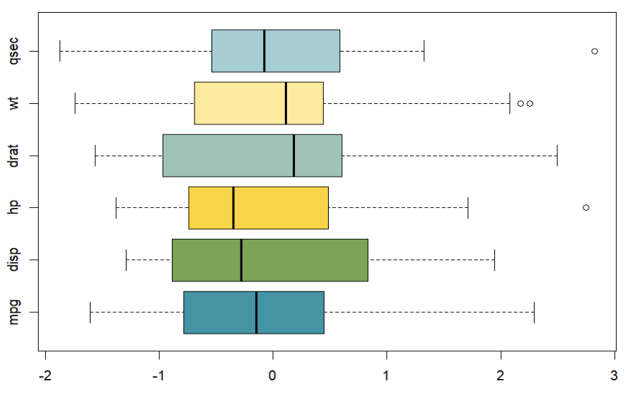
EDA and Data Pre-processing
The variables 'qsec', 'hp', and 'disp' exhibit lower medians and narrower ranges compared to 'wt', 'drat', and 'mpg’.
Distribution of most of the numeric data are skewed either to the right or left with 'qsec', 'hp', and 'disp' being skewed to the right, 'wt' and 'drat' to the left, and 'mpg' appearing to be symmetric.

Slide 59
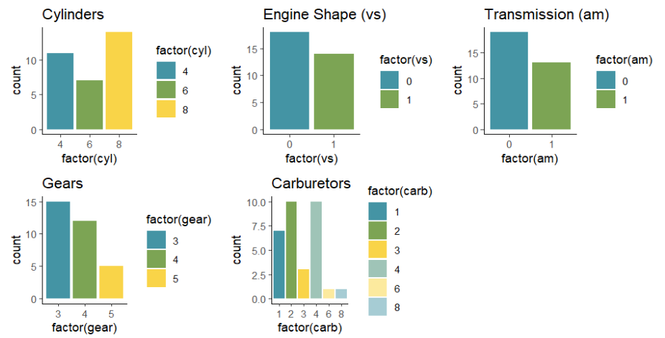
EDA and Data Pre-processing

Slide 60
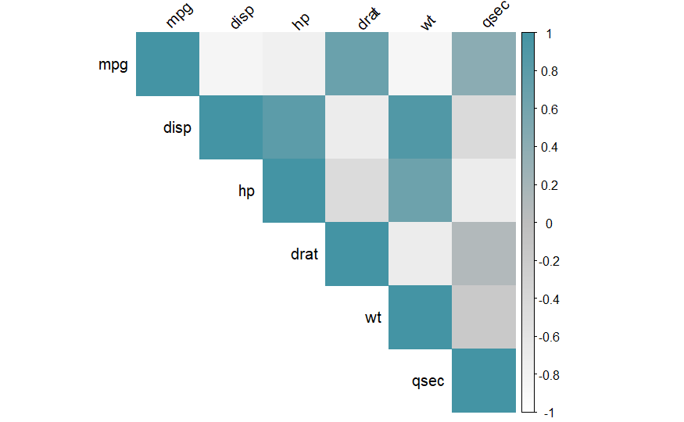
EDA and Data Pre-processing
We can clearly see that there exists multicollinearity between numerical features in the dataset.

Slide 61
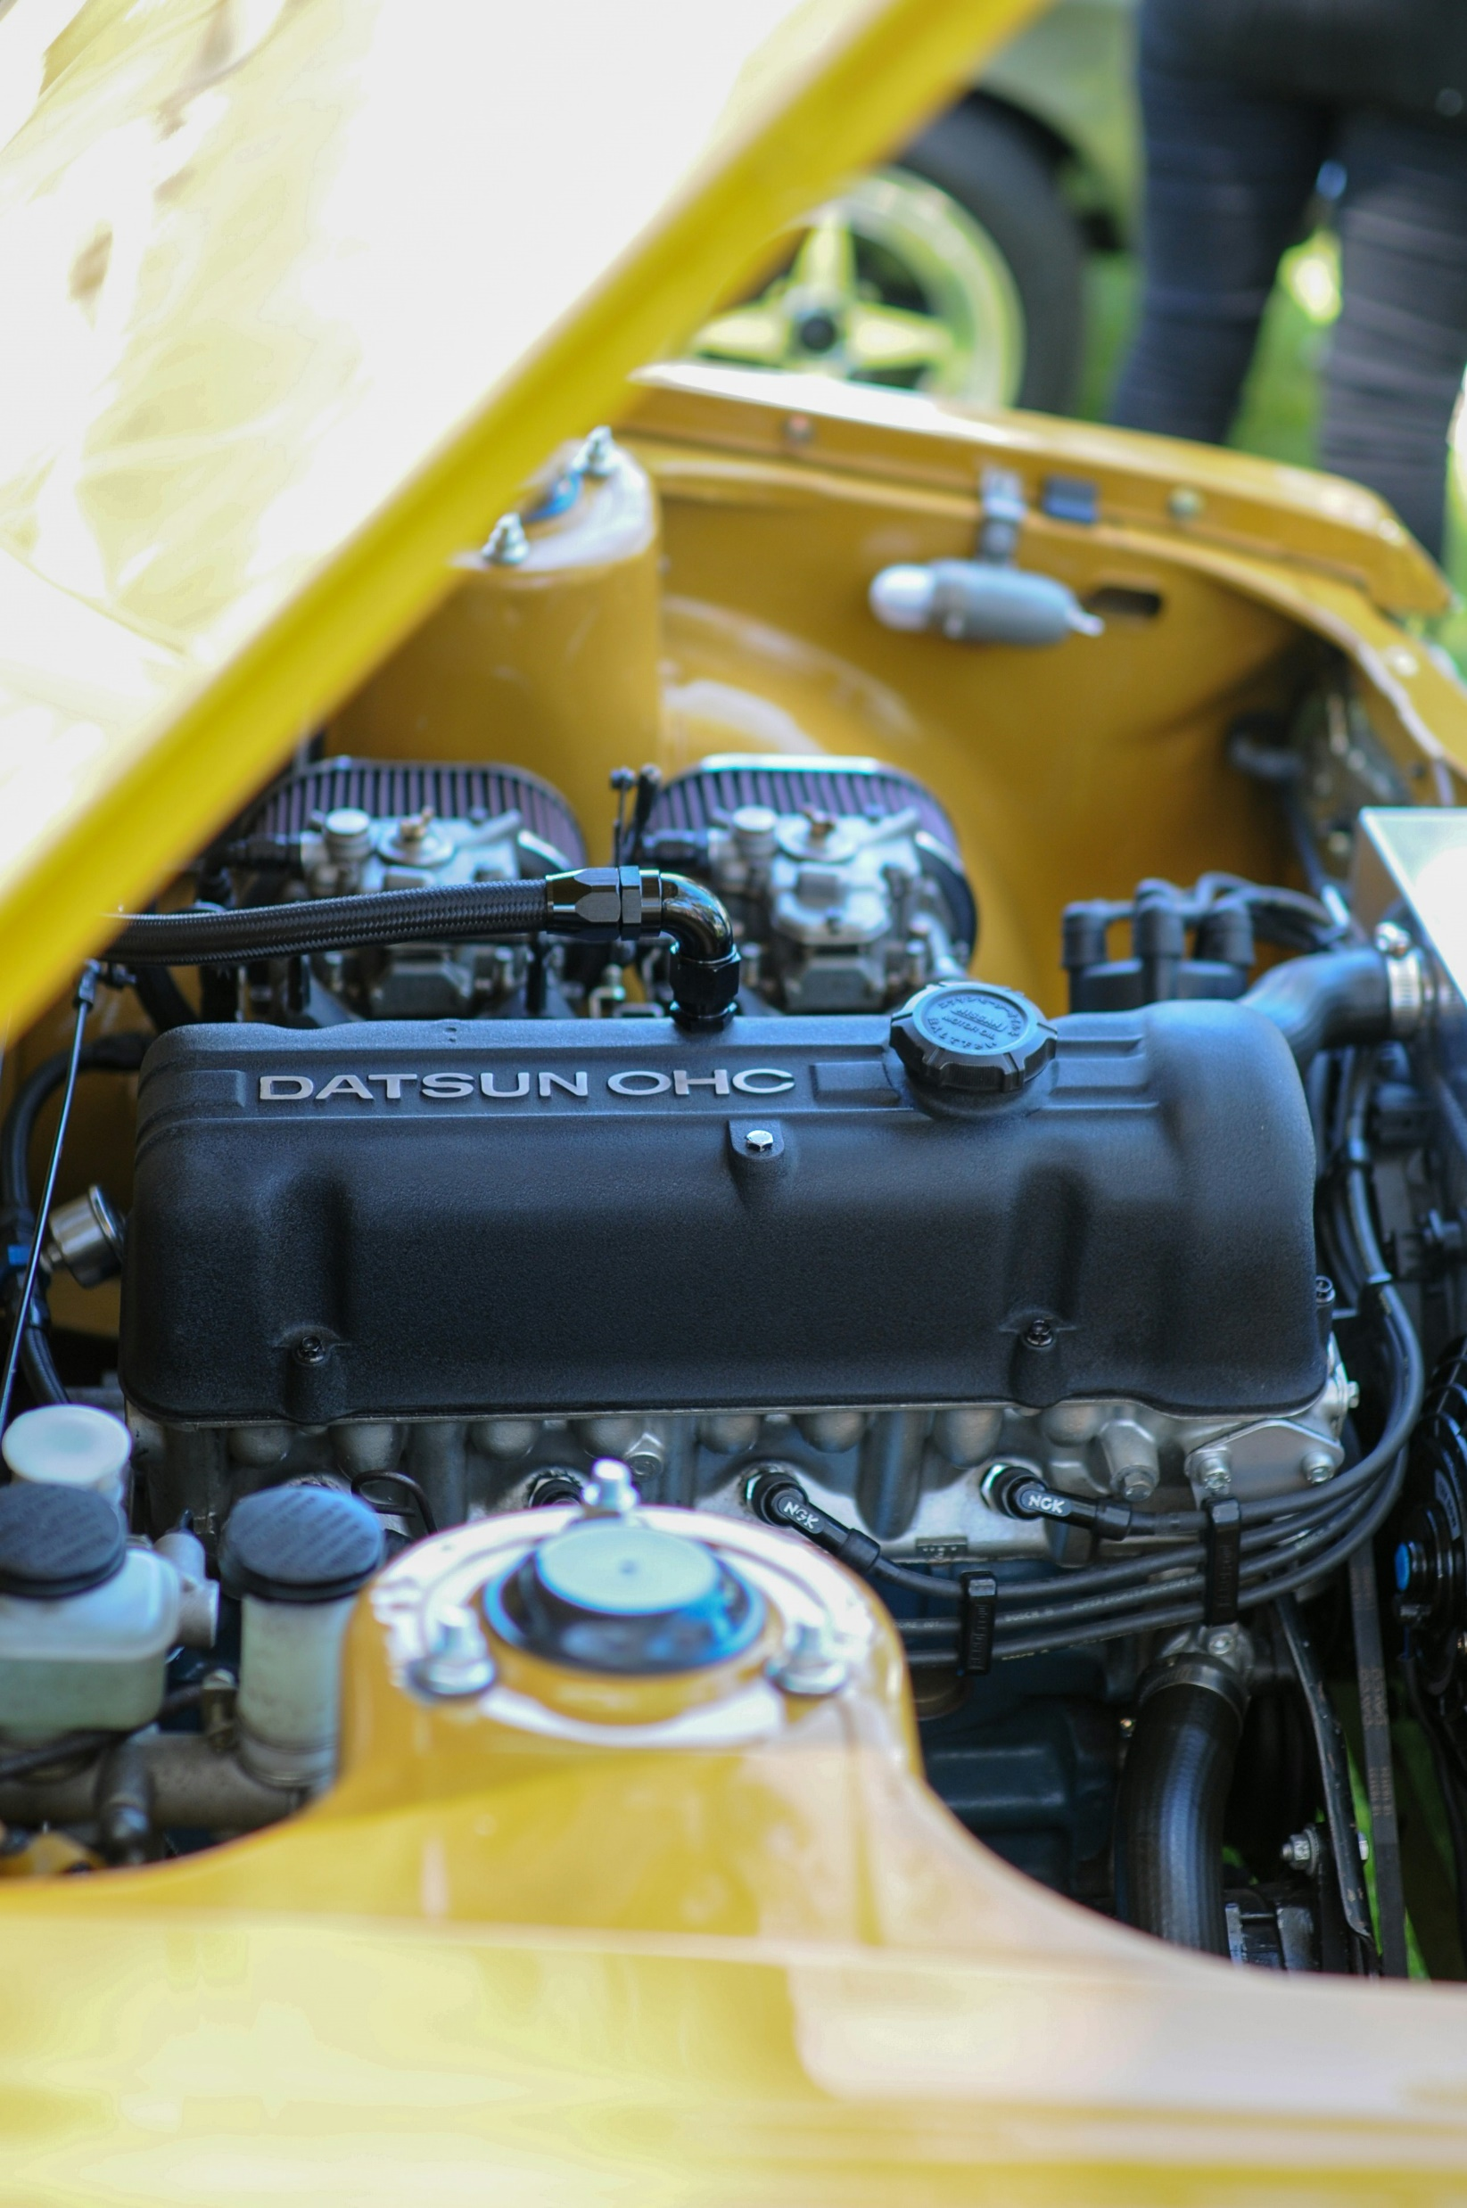
03
Pre-clustering Assessment

Slide 62
Pre-clustering Assessment
Cluster Tendency
Hopkins Statistic
VAT ( Visual Assessment Tendency)
Optimal Number of Clusters
Silhouette Method
GAP Statistics

Slide 63
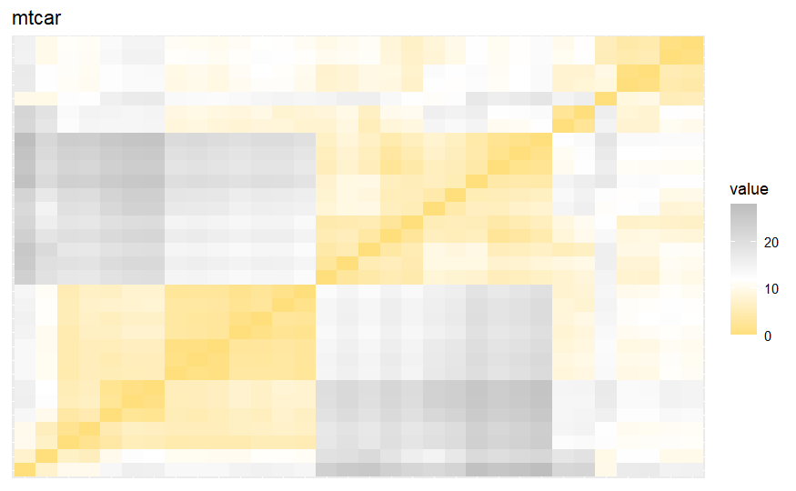
Assessing Clustering Tendency
Hopkins Statistics:
0.9999998

Slide 64
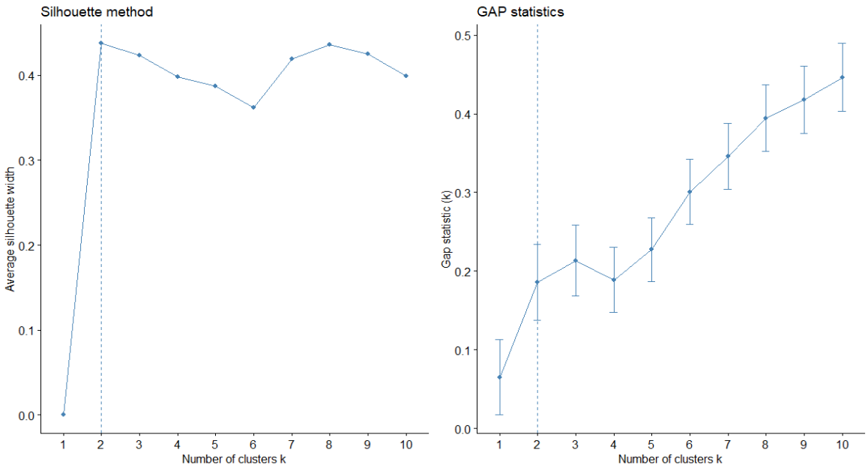
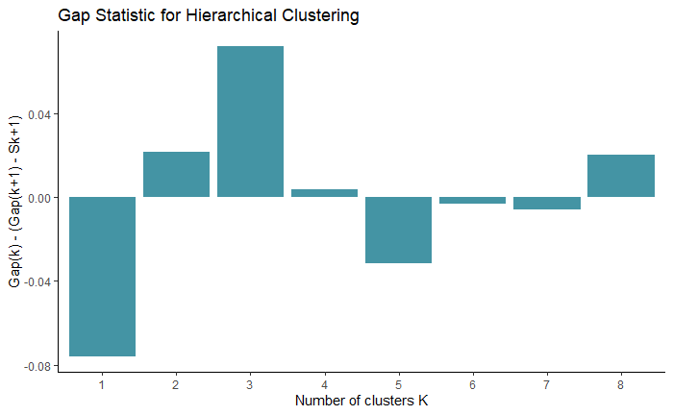
Finding Optimal Number of Clusters
• Silhouette method: 2 clusters solution suggested
• Gap statistic method: 2 clusters solution suggested
According to these observations, it’s possible to define k = 2 as the optimal number of clusters in the data.

Slide 65

04
Cluster Analysis

Slide 66
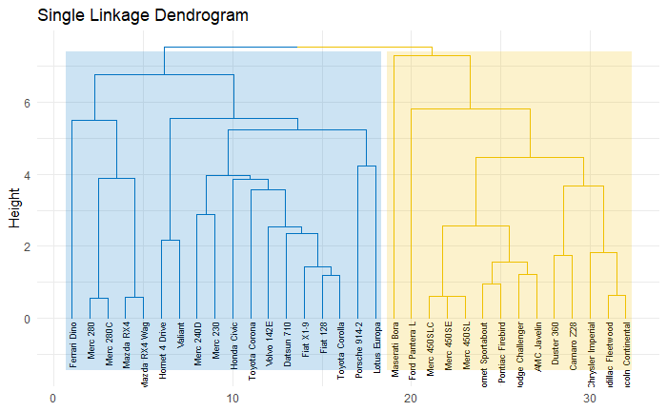
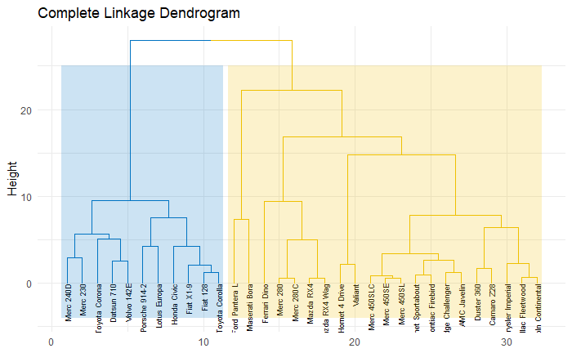
Agglomerative Hierarchical Clustering

Slide 67

Agglomerative Hierarchical Clustering

Slide 68


Agglomerative Hierarchical Clustering

Slide 69
Interpretation
Single Linkage Method: The dendrogram shows a more elongated appearance, with many small clusters merging at lower heights. Single linkage can sometimes lead to "chaining," where clusters are formed by connecting single points, resulting in elongated and less compact clusters.
Complete Linkage Method: The dendrogram appears more balanced, with clusters merging at higher heights compared to single linkage. Complete linkage tends to create clusters with smaller maximum distances between points within the same cluster, resulting in more compact clusters compared to single linkage.
Average Linkage Method: The dendrogram for average linkage shows clusters merging at intermediate heights. Average linkage provides a compromise between single and complete linkage by averaging the distances between points in different clusters to determine the merging points, leading to moderately compact clusters.
Ward.D Method: The dendrogram for Ward.D shows that clusters merge at relatively high heights. This method aims to minimize the total within-cluster variance, leading to more compact and spherical clusters.
Ward.D2 Method: Similar to Ward.D, the Ward.D2 method shows clusters merging at higher heights, indicating a tendency to form more compact and spherical clusters with small within-cluster variance.

Slide 70

Correlation Matrix Between
Dendrograms
Strong
Moderate
Weak
WardD and WardD2 are very similar to each other, indicating that the results from these methods are almost identical.
Single Linkage and Average Linkage also are similar to each other.
Correlation between Complete and WardD appears to be relatively weak.
Notes:
DO NOT REMOVE THIS SLIDE – LINKED ON PREVIOUS SLIDE
(Zooms in to this image on slide show)

Slide 71

Linkage Method | Cophenetic Correlation
Single | 0.7675238
Complete | 0.7858564
Average | 0.8010725
Ward.D | 0.7494353
Ward.D2 | 0.7667039
In this case, the Average linkage method has the highest cophenetic correlation coefficient (0.8010725), followed closely by the Complete linkage method (0.7858564). However, we observed from dendrogram of Complete Linkage Method that it is not appropriate method for us. That's why we will continue These methods are the best fit for our data based on the cophenetic correlation coefficient.
Notes:
DO NOT REMOVE THIS SLIDE – LINKED ON PREVIOUS SLIDE
(Zooms in to this image on slide show)

Slide 72

Clusters based on the Average Linkage Method
Cluster 1
18 car models
Cluster 2
14 car models
Notes:
DO NOT REMOVE THIS SLIDE – LINKED ON PREVIOUS SLIDE
(Zooms in to this image on slide show)

Slide 73
Comparing
Average vs. Complete
We compared different linkage methods using the cophenetic correlation and found that the top two methods are the average linkage method and the complete linkage method. Now, we will compare these two linkage methods with each other.

Slide 74

Comparing Average vs Complete
The entanglement value of 0.16 suggests a moderate level of similarity between the two clustering methods. The colored lines highlight how certain car models are grouped differently, reflecting the sensitivity of hierarchical clustering to the choice of linkage method. This comparison helps in understanding how different linkage criteria can impact the resulting clusters.

Slide 75

05
Cluster Validation

Slide 76

Internal Validation
Optimal Scores for Average Linkage Method:
 | Score | Method | Clusters
Connectivity | 3.7179 | hierarchical | 2
Dunn | 0.5860 | hierarchical | 5
Silhouette | 0.5071 | hierarchical | 2

Slide 77

Internal Validation
Optimal Scores for Average Linkage Method:
 | Score | Method | Clusters
Connectivity | 3.7179 | hierarchical | 2
Dunn | 0.5860 | hierarchical | 5
Silhouette | 0.5071 | hierarchical | 2

Slide 78

Internal Validation
Optimal Scores for Average Linkage Method:
 | Score | Method | Clusters
Connectivity | 3.7179 | hierarchical | 2
Dunn | 0.5860 | hierarchical | 5
Silhouette | 0.5071 | hierarchical | 2

Slide 79

Stability Validation
Optimal Scores for Average Linkage Method:
 | Score | Method | Clusters
APN | 0.0249 | hierarchical | 5
AD | 4.2413 | hierarchical | 6
ADM | 0.1348 | hierarchical | 5
FOM | 0.5416 | hierarchical | 5

Slide 80

Stability Validation
Optimal Scores for Average Linkage Method:
 | Score | Method | Clusters
APN | 0.0249 | hierarchical | 5
AD | 4.2413 | hierarchical | 6
ADM | 0.1348 | hierarchical | 5
FOM | 0.5416 | hierarchical | 5

Slide 81

Stability Validation
Optimal Scores for Average Linkage Method:
 | Score | Method | Clusters
APN | 0.0249 | hierarchical | 5
AD | 4.2413 | hierarchical | 6
ADM | 0.1348 | hierarchical | 5
FOM | 0.5416 | hierarchical | 5

Slide 82

Stability Validation
Optimal Scores for Average Linkage Method:
 | Score | Method | Clusters
APN | 0.0249 | hierarchical | 5
AD | 4.2413 | hierarchical | 6
ADM | 0.1348 | hierarchical | 5
FOM | 0.5416 | hierarchical | 5

Slide 83

06
Conclusion and Recommendation

Slide 84
Conclusion
Applied agglomerative hierarchical clustering to analyze the automobile dataset
Recommendation
Apply Additional Clustering Techniques
Further Research and Integration
Used various linkage methods to determine the optimal clustering approach.
After comparing the performance of different methods, found that the Average Linkage method provided the most meaningful and well-separated clusters.
This method effectively grouped the car models into distinct categories, highlighting underlying patterns and characteristics, thereby aiding in better understanding and targeting of specific vehicle segments within the industry.

Slide 85

Research Question #2
How can we identify and interpret similarities in features within clustering results to enhance the understanding of cluster formation and structure?

Slide 86
Importance of Identifying Feature Similarities
Enhanced Understanding: Provides insights into the underlying patterns and relationships within the data.
Interpretability: Helps in making sense of the clusters, making the results more actionable and meaningful.
Data-Driven Decisions: Facilitates informed decisions based on the characteristics of each cluster.
Validation: Ensures the clustering results are logical and align with domain knowledge.

Slide 87
Methods to Identify and Interpret Clusters
Methods | Objective | Implementation | Use Case
Descriptive Statistics | Summarize and describe the features of each cluster. | Mean and Median, Standard Deviation and Range | In customer segmentation, calculate the average age, income, and spending score for each cluster.
Visualizations | Provide a graphical representation of feature similarities and differences within clusters. | Box Plots, Heatmaps, Pairwise Scatter Plots | In customer segmentation, visualize the average age, income, and spending score for each cluster.
Feature Importance Analysis | Determine the most significant features contributing to cluster formation. | Decision Trees, Feature Importance Scores | In a marketing dataset, use a decision tree to identify the key demographic features driving customer segmentation.
Cluster Profiles | Create detailed profiles for each cluster based on feature similarities. | Centroids, Cluster Summaries | In healthcare data, create profiles for patient clusters based on average age, medical history, and treatment outcomes.
Correlation Analysis | Assess the relationships between features within clusters. | Correlation Coefficients, Correlation Matrices | In financial data, analyze the correlation between different financial indicators within investor clusters.

Slide 88
Clusters based on the Average Linkage Method
Cluster 1
18 car models
Cluster 2
14 car models

Slide 89
Descriptive Statistics per Cluster
 | Cluster 1 | Cluster 2
mpg | Range: 17.80 to 33.90 Median: 22.15 Mean: 23.97 | Range: 10.40 to 19.20 Median: 14.30 Mean: 15.10
disp | Range: 71.10 to 258.00 Median: 130.90 Mean: 135.54 | Range: 275.8 to 472.0 Median: 351.0 Mean: 353.1
hp | Range: 52.00 to 175.00 Median: 101.00 Mean: 98.06 | Range: 150.0 to 335.0 Median: 209.0 Mean: 209.2
drat | Range: 2.76 to 4.93 Median: 3.91 Mean: 3.88 | Range: 2.76 to 4.22 Median: 3.08 Mean: 3.23
wt | Range: 1.513 to 3.460 Median: 2.605 Mean: 2.609 | Range: 3.170 to 5.424 Median: 3.755 Mean: 3.756

Slide 90
Descriptive Statistics per Cluster
 | Cluster 1 | Cluster 2
cyl | Range: 4 to 6 Median: 4 Mean: 4.778 | Range: 8 Median: 8 Mean: 8
vs | Range: 0 to 1 Median: 1 Mean: 0.778 | Range: 0 Median: 0 Mean: 0
am | Range: 0 to 1 Median: 1 Mean: 0.611 | Range: 0 to 1 Median: 0 Mean: 0.1429
gear | Range: 3 to 5 Median: 4 Mean: 4.000 | Range: 3 to 5 Median: 3 Mean: 3.286
carb | Range: 1 to 6 Median: 2 Mean: 2.278 | Range: 2 to 8 Median: 4 Mean: 3.50
Notes:
Cluster 1: Contains cars with fewer cylinders (mostly 4, some 6), a mix of engine shapes (more straight engines), a higher proportion of manual transmissions, typically 4 gears, and fewer carburetors. These cars are generally lighter and more fuel-efficient, indicating they might be more economical or everyday vehicles.
Cluster 2: Consists exclusively of cars with 8 cylinders, V-shaped engines, mostly automatic transmissions, typically 3 gears, and more carburetors. These cars are heavier and less fuel-efficient, indicating they might be more powerful or performance-oriented vehicles.

Slide 91

Visualization of Features per Cluster

Slide 92

Visualization of Features per Cluster

Slide 93
Clusters based on the Average Linkage Method
Cluster 1
18 car models
Cluster 2
14 car models
Notes:
As I mentioned earlier, interpreting clustering results allows us to validate whether they align with our domain knowledge. Now that we know Cluster 1 consists of economical cars, we can verify this by identifying models such as the Toyota Corolla, Honda Civic, and Fiat. On the other hand, Cluster 2 contains more powerful cars, including models like the Maserati, Camaro, Chrysler, and Cadillac.

Slide 94
Cluster Interpretation
Cluster 1
Cars in this cluster typically have:
Lower horsepower (hp)
Higher fuel efficiency (mpg)
Lower weight (wt)
Smaller engine displacement (disp)
Fewer cylinders (cyl)
These characteristics suggest that cars in Cluster 1 are generally more economical and smaller, possibly including compact and subcompact cars.
Cluster 2
Cars in this cluster typically have:
Higher horsepower (hp)
Lower fuel efficiency (mpg)
Higher weight (wt)
Larger engine displacement (disp)
More cylinders (cyl)
These characteristics suggest that cars in Cluster 2 are generally more powerful and larger, possibly including sports cars, muscle cars, and luxury cars.

Slide 95
Thank you

